Slide 1
Individual: Public Cloud Development Presentation
Yasir Abdulsahib
CSS/422
October 22,2018
Annie O’Rourke

Slide 2
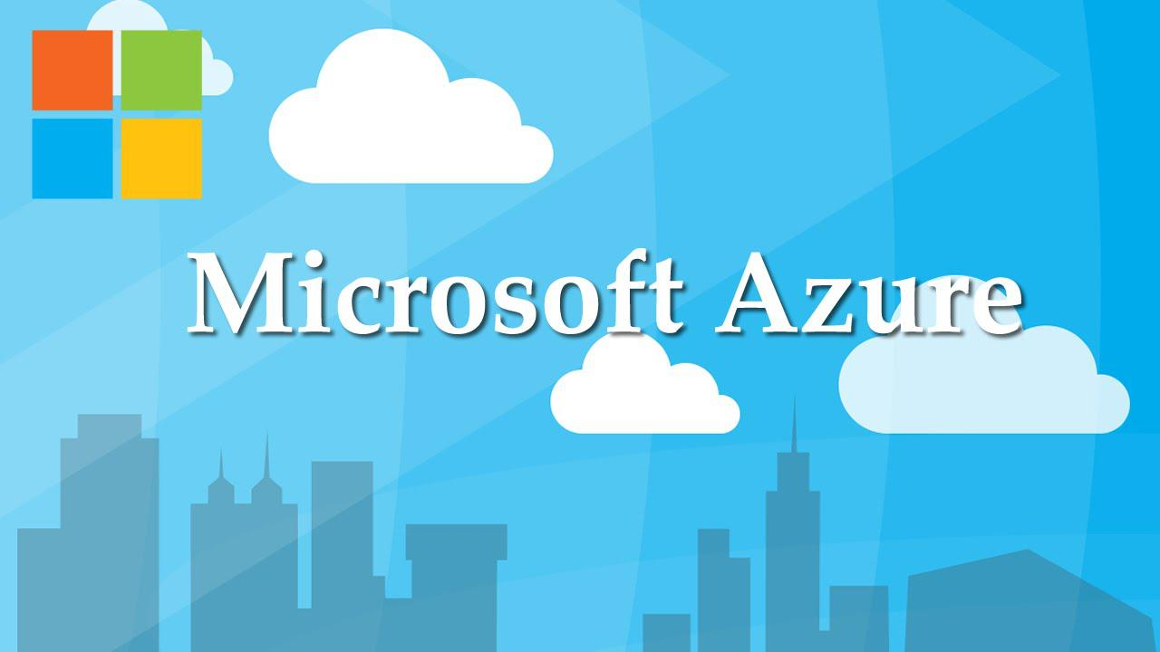
Introduction
Notes:
Choosing the best hosting company for your site should be at the top of your priorities pyramid, because choosing a good hosting will relieve you of a lot of problems.
In this presentation I will present a comparison between Microsoft Azure and the traditional companies and I will explain the strengths, differences, and benefits of Azure.

Slide 3
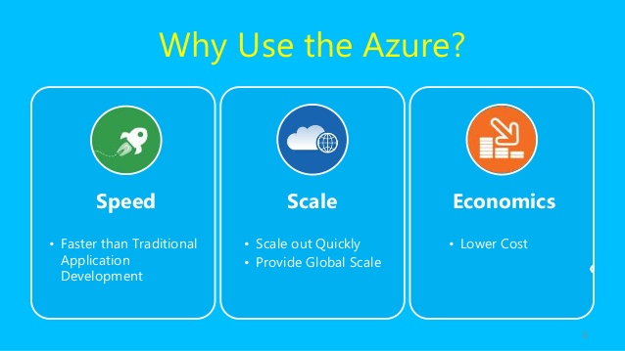
Pros of using Microsoft Azure
Microsoft Azure continues to gain a lot of traction in the cloud storage and business worlds.
High Availability
Security
Scalability
Cost effectiveness
Notes:
Microsoft Azure cloud offers high availability and redundancy in data centers on a global scale.
Microsoft Azure has a strong focus on security, following the standard security model of Detect, Assess, Diagnose, Stabilize and Close.
With this scalability structure, businesses have the flexibility to pay for only what they use.
Azure’s pay-as-you-go pricing allows SMBs to better manage their IT budgets, purchasing only as much as they need.

Slide 4

Cons of using Microsoft Azure
Requires Management
Requires Platform Expertise
Notes:
As with most cloud service providers, Azure needs to be expertly managed and maintained, which includes patching and server monitoring.
Unlike local servers, Azure requires expertise to ensure all moving parts work together efficiently.

Slide 5

Cloud vs. Traditional Hosting
Traditional Hosting is mainly of two types
Shared hosting
Dedicated hosting
Notes:
In shared hosting, you share a server with many other websites and customers.
In dedicated hosting, you own a complete server to yourself.
In both cases, this hosting is undesirable from most large companies because of the lack of security of information, you must provide protection of your information and way of communication and face contact as well as database.

Slide 6
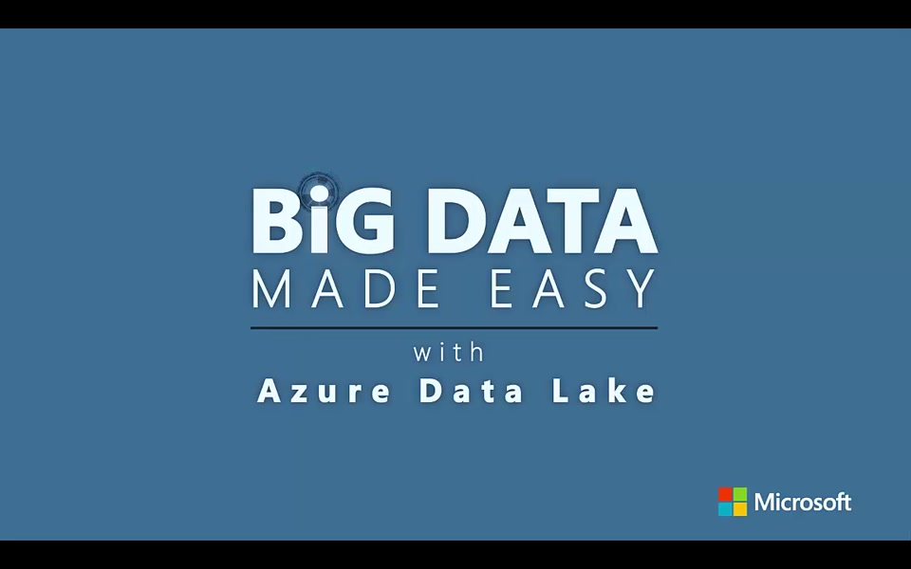
Microsoft Azure benefits
Provide Big Data
Notes:
Often, we store many data and then leave it until we return to it later but leaving this data for a long time needs to manage this data, which provides by Microsoft Azure, so we don’t have to warry about the big data we left it in behind.

Slide 7
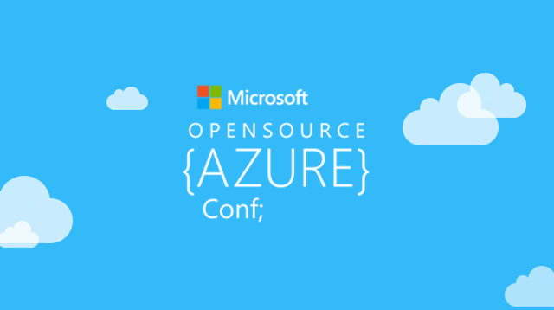
Azure for open source
Discover more options with open source on Azure
Notes:
With Azure, you have choices. Choices that help you maximize your existing investments.
You bring the tools you love and skills you already have, and run virtually any application, using your data source, with your operating system, on your device.

Slide 8

Conclusion
Notes:
We conclude from the above that the that when you want to host a web-based application you should use one of the companies who proving this service, but here you must determine which company will meet the security and performance requirements.

Slide 9

Questions
Notes:
Thank you for your time
Any questions please ?

Slide 10
Reference
What Are the Pros and Cons of Microsoft Azure?(2018). Retrieved from https://blog.icorps.com/pros-and-cons-microsoft-azure
Cloud vs. Traditional Hosting (2018). Retrieved from http://www.exelanz.com/blogs/cloud-vs-traditional-hosting/

